Slide 1


enditnow®
EMPHASIS DAY 2022
ABUSE of POWER
Written by Ardis and Dick Stenbakken
PREPARED BY THE
GENERAL CONFERENCE
WOMEN’S MINISTRIES
Notes:
POWER OF AUBSE
Written by Ardis and Dick Stenbakken
For enditnow® Emphasis Day 2022
Prepared by General Conference Women’s Ministries
[Note to presenter: To begin your sermon, show the congregation some type of sharp instrument: a cooking type knife (best example) or an Xacto Knife, woodcarving tool, or a sword or an ax. Ask someone in the congregation to come up to inspect the knife. Ask them, “Is this good or bad? Harmful or useful?” Encourage this person if necessary to indicate that something sharp is neither good nor bad in itself—it is how it is used. Thank them for their help.]

Slide 2


“Is this
good or bad?
Harmful or useful?”
Notes:
INTRODUCTION
Is this good or bad? Harmful or useful?
You realize of course that we must be careful, not careless, with something sharp. We must also be careful, not careless, with power. Power itself is not good or bad—it just is. But power can be used for great good or for great harm.
Automobiles and airplanes have power to do great good for us, getting us places we need to go. But their power also can be abused for great harm when they become killing machines.

Slide 3
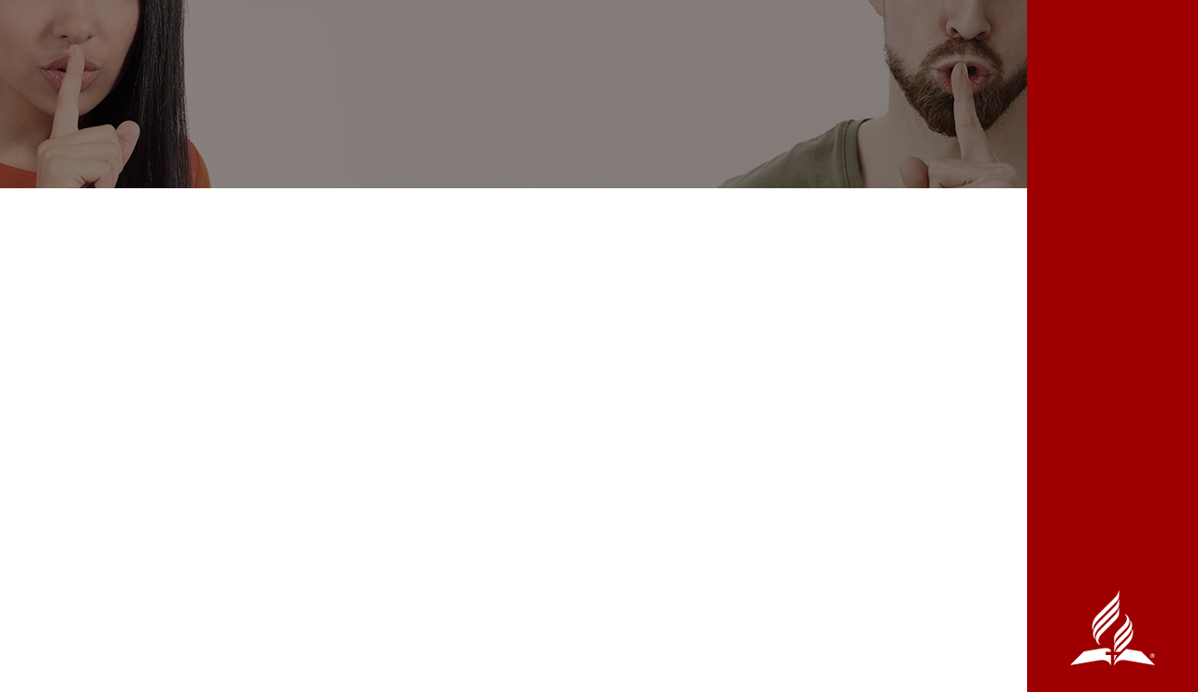
ABUSE OF POWER
IN THE BIBLE
The first and most obvious is that of Lucifer who became known as Satan.
Pharaoh abused his power. (Exodus 10:28)
Eli’s sons. (I Samuel 2:22-25)
King David
Notes:
ABUSE OF POWER IN THE BIBLE
The Bible is full of stories about power, the good use of power, and the abuse of power: The first and most obvious is that of Lucifer who became known as Satan. He had power, but he wanted more power. He used his position to poison the minds of a third of the angels. Not satisfied with causing them to fall, he went to work on Adam and Eve and all those who came after. The abuser and the abused are hurt—but Satan will get his final punishment at the end of the thousand years.
The misuse of power is often subtle. It can be seen in manipulation. This certainly happened in the Garden of Eden. Sometimes the abuse of power comes in the form of “Poor me,” or by causing one to doubt; this again was used in the Garden of Eden. And sometimes the abuser tries to force by saying, “After all I’ve done for you!” All these statements are dishonest, abusive, and manipulative.
Note to presenter:
This section, Abuse of Power in the Bible, continues by discussing Pharaoh and Eli’s sons. The biblical narrative continues through the next section, Abuse of Power by King David. You will find the complete script in the packet.

Slide 4
POSITIONAL POWER
Lawyer
Teacher
Coach
Caregiver
Doctor
Therapist
Boss/VIP/political
Husbands/wives
Parents
Church Leaders – including youth/Pathfinder leaders, pastors, elders, etc.
Notes:
KINDS OF POWER
Let’s look at some of the many kinds of power.
There is a kind of power we will call positional. This means that a person has power because of their position. Some of these positions are:
Pastor
Lawyer
Teacher
Coach
Caregiver
Doctor
Therapist
Boss
VIP/political
Husband/wife
Parent
Adult child of aging parent/s
Church leader:
including youth and Pathfinder leaders, elders, etc.
Probably we have mentioned every single adult person in church in one or more of the categories. Generally, we look up to these people and respect them. But if they abuse their power, great harm can come. We will look at this more closely a little later.

Slide 5
OTHER TYPES
OF ABUSE OF POWER
Economic
Influence
Physical
Informational
Psychological
Emotional
Spiritual
Sexual
Notes:
Other types of power can be:
Economic—the use or misuse of money and trust in managing funds; the person wields power because they have the money—they are looked up to, or they control things or events with their money by either giving or withholding it.
Influence—the use of persuasion because they have written a book, are a member of a certain group, have a forceful personality, etc. Think of people in sports, entertainment, music, social media, and other well-known people who influence followers and endorse advertisements. They have the power of persuasion.
Physical—usually the use of size or physical strength to force compliance. This is perhaps obvious—if you are bigger or stronger than I, you have power over me.
Informational—the use of information that another lacks or needs gives power to the one who knows. This is particularly true in church leadership and political leadership. If you are on the inside path of information, you can control events and people.
Psychological and Emotional—the use of emotions to dominate shame, manipulate or control others. Ephesians 6:4 says, “Do not exasperate your children.”
Spiritual—the use of spiritual influence or position to command, demand, demean, or force someone into a belief or behavior.
Sexual—the exploitation of another for personal sexual gratification. The abuse by these individuals may be in the form of sexual abuse, incest, molestation, harassment, verbal and/or emotional abuse, or taking advantage of a person or group for the benefit of the abuser. Note: In many countries there are strong legal guidelines on reporting, and potentially severe legal penalties for this kind of abuse, especially the abuse of minor children.
Some of you sitting here may say, “Well, I am not in any of those categories. I have NO power.” But everyone has power in some sphere, and we must all respect boundaries and be held accountable for the use of that power. Usually the person who feels they have no power becomes the victim. You need to be aware and protect yourself.

Slide 6
ABUSE OF POWER
IN THE CHURCH
Around the world there are more and more stories in the press and by word of mouth about the abuse of power.
When boundaries are crossed, someone always gets hurt, and often it is the person who has the power as well as the “victim.” And when it is a church leader not only do the individuals get hurt, but so does the church and the mission of the church.
Notes:
ABUSE OF POWER IN THE CHURCH
Around the world we hear more and more stories in the press and by word of mouth about the abuse of power. We are all probably aware of another church that has been in the news because of abuse of children by the priests. We doubt that the problem is worse in any one area of the world, but some areas are more open about the problem. We are proud of the fact that the Seventh-day Adventist Church has been more proactive regarding abuse by pastors, teachers, and other church leaders. But we will never solve the problem by pretending abuse does not happen. Because it does.
In February of 2008, an article was published in Ministry, an International Journal for Pastors® [1] about Adventist Risk Management, the Seventh-day Adventist Church’s insurance company. One of the directors, in answer to questions about abuse by church leaders, says, “Abuse happens. Some denominations have taken the position to deny, deny, deny—until the courts intervene…. The expertise the whole group (Adventist Risk Management) has developed together comes into action to try to minimize the pain and suffering caused by the abuse….The moment the complainants become angry, they turn against the church, they turn against the individuals who are trying to help them. And recovery for them becomes virtually impossible.” You see, when power is abused, people get hurt. And often they lose their trust in God as well.
When boundaries are crossed, someone always gets hurt, and often it is the person who has the power as well as the “victim.” And when it is a church leader not only do the individuals get hurt, but so does the church and the mission of the church. We will talk more about this in the Abuse of Power seminar.
[Note to presenter: This is a good time to advertise the time and place of the seminar.]
ABUSE OF POWER OUTSIDE THE CHURCH
In the United States, just under 500 educators were arrested on the incidences of sexual abuse in schools in 2015 according to statistics [2] —which was of course an abuse of power. Those who abused were hurt; those who were abused were hurt, sometimes for life. As an experiment, “Abuse of power” was entered into the Google internet search engine and then the countries Ghana, the Philippines, Sweden, Canada, Singapore, New Zealand, Jamaica, Syria, and Austria were entered one by one—any and every part of the world.
In a 2019 survey, 28 percent of Americans said that they think a sizable minority of elected officials break the law or abuse the powers of their office. On the other hand, 12 percent of Americans reported that they think almost all elected officials abuse the powers of their office.[3]
According to The National Intimate Partner and Sexual Violence Survey, in the United States, between 2010 and 2012, each year an average of almost five million women suffered contact sexual violence, and almost a million and a half were raped. None of these incidents were about sex—these were abuse of power.[4]
[1] Published monthly for pastors and clergy since 1928 by the Seventh-day Adventist Church.
[2] https://theaquilareport.com/sexual-abuse-by-teachers-is-on-the-rise/. Accessed 2/7/2022.
[3] https://www.statista.com/statistics/1079418/number-elected-officials-americans-think-break-law-abuse-powers/ Accessed 2/24/2022.
[4] https://www.cdc.gov/violenceprevention/pdf/NISVS-StateReportBook.pdf/ Accessed 2/24/2022.

Slide 7
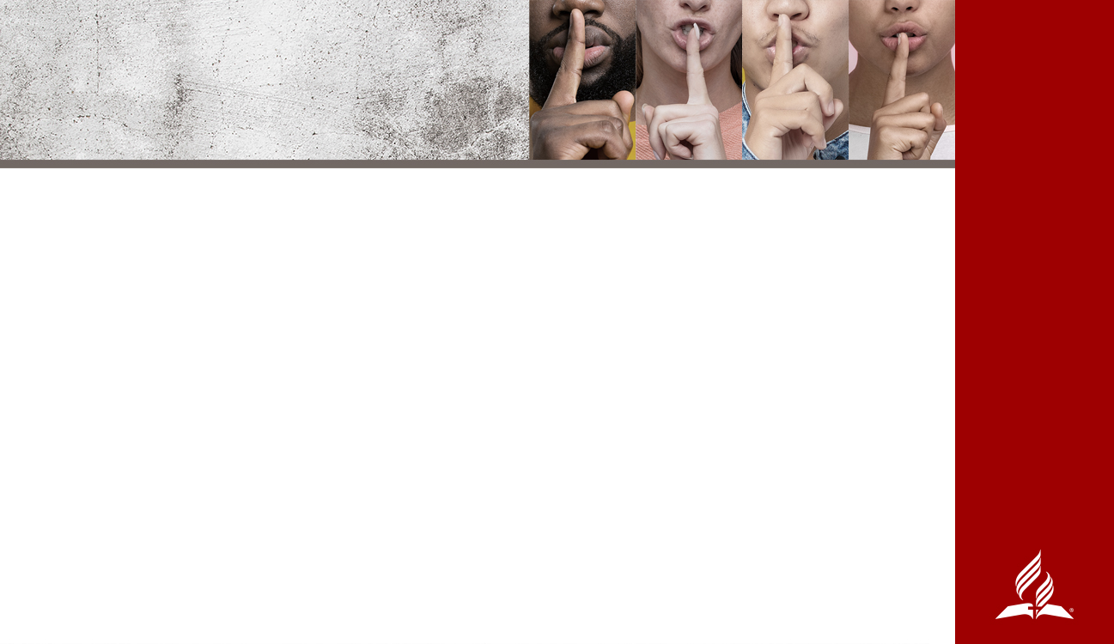
WHAT CAN WE DO?
FIRST, ADMIT THAT WE COULD BE GUILTY OF ABUSING POWER
Accountability - As a pastor, or other spiritual leader or teacher, any person in power, you must recognize that God holds you more accountable and responsible for keeping His standard, not only for your words, but for your whole manner of life.
Notes:
WHAT WE CAN DO
What do we do about this problem? Is there a solution? Any good news? Oh yes!
First, we must each admit that we could be guilty of abusing power in some place in our life if we don’t let the Holy Spirit guide us in all things. We must beware of allowing ourselves to be victims or abusers of power. As members of a congregation, members of a community, members of a family, we must hold people accountable— and hold ourselves accountable before God.
So, these are some of the things we can and must pay attention to:
Accountability. As a pastor, or other spiritual leader or teacher, any person in power, you must recognize that God holds you more accountable and responsible for keeping His standard, not only for your words, but for your whole manner of life. “Let not many of you become teachers, my brethren, knowing that as such we will incur a stricter judgment” (James 3:1, NASB).

Slide 8
Mutuality - When we meet on mutual ground, no one overpowering another, we can best work together. If there is inequality at any level, someone is disadvantaged and there is a much greater chance for power to be misused and for abuse to take place.
Notes:
Mutuality. When we meet on mutual ground, no one overpowering another, we can best work together. If there is inequality at any level, someone is disadvantaged and there is a much greater chance for power to be misused and for abuse to take place.

Slide 9
WHAT CAN WE DO?
Respect - We must respect our own boundaries, our own bodies, and our own power. That means not using them to abuse, nor allowing abuse to happen to us.
Collaboration - In the very beginning, Adam and Eve were both given control. Neither one was to use their power over the other. When we work with, not over others, a much better result occurs.
Notes:
Respect. We must respect our own boundaries, our own bodies, and our own power. That means not using them to abuse, nor allowing abuse to happen to us. Paul makes this very clear in “I appeal to you therefore, brothers and sisters, by the mercies of God, to present your bodies as a living sacrifice, holy and acceptable to God, which is your spiritual worship” (Romans 12:1, NRSV), and “Do you not know that your body is a temple of the Holy Spirit, who is in you, whom you have received from God? You are not your own” (1 Corinthians 6:19).
Collaboration. Again, we have biblical examples. In the very beginning, Adam and Eve were both given control. Neither one was to use their power over the other. When we work with, not over others, a much better result occurs. In the New Testament it is interesting that Joseph and Mary were both given visions. Elizabeth and Zachariah worked together in training their son, John. Look at the word itself: co (together) labor (to work)…to work together.
Ananias and Sapphira are a negative example of collaboration that was abusive. They had financial power—why they decided to deceive with it we are not told. But it illustrates the seriousness of sin within the church, the sensitivity of the Holy Spirit to sin, and the quick judgment of God upon sin.[1]
[1] Acts 5:1-11

Slide 10

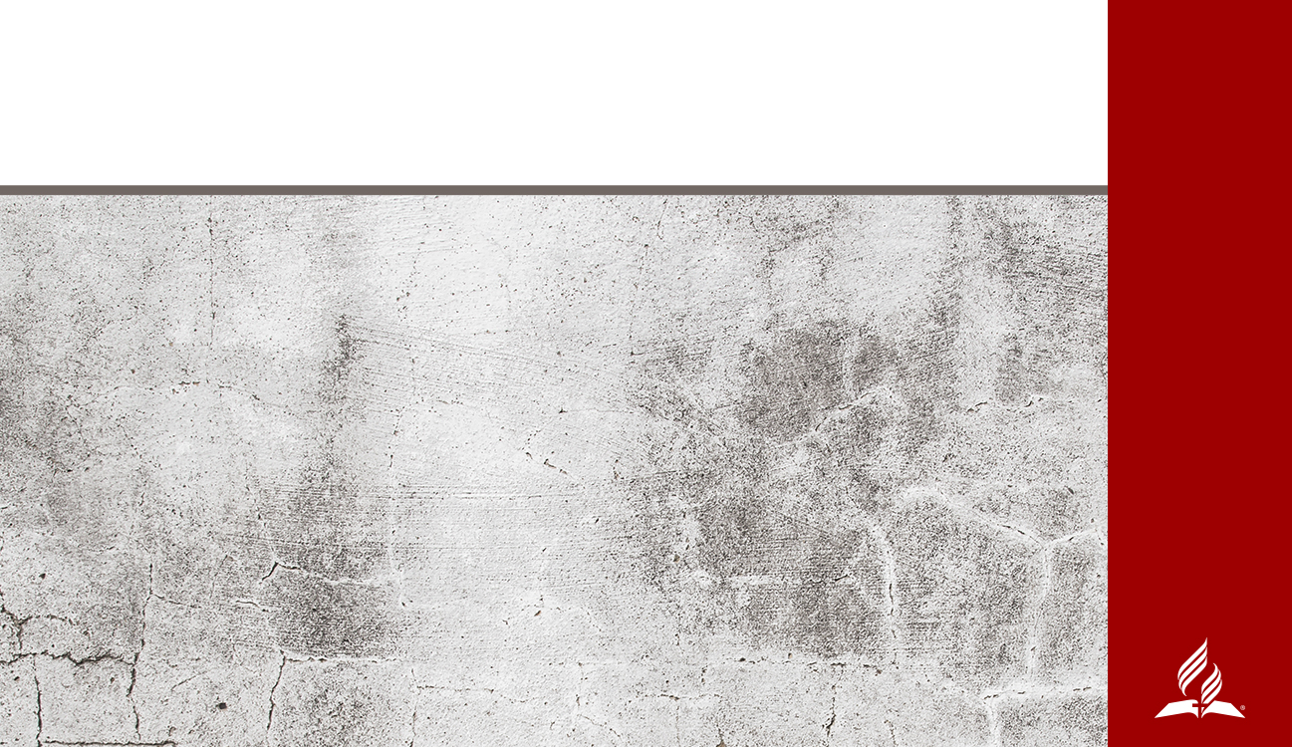
Positive Illustrations
in Ephesians
Notes:
POSITIVE ILLUSTRATION IN EPHESIANS
For a beautiful illustration of combined and positive accountability, mutuality, respect, and collaboration, look at what Paul wrote in Ephesians 4.

Slide 11
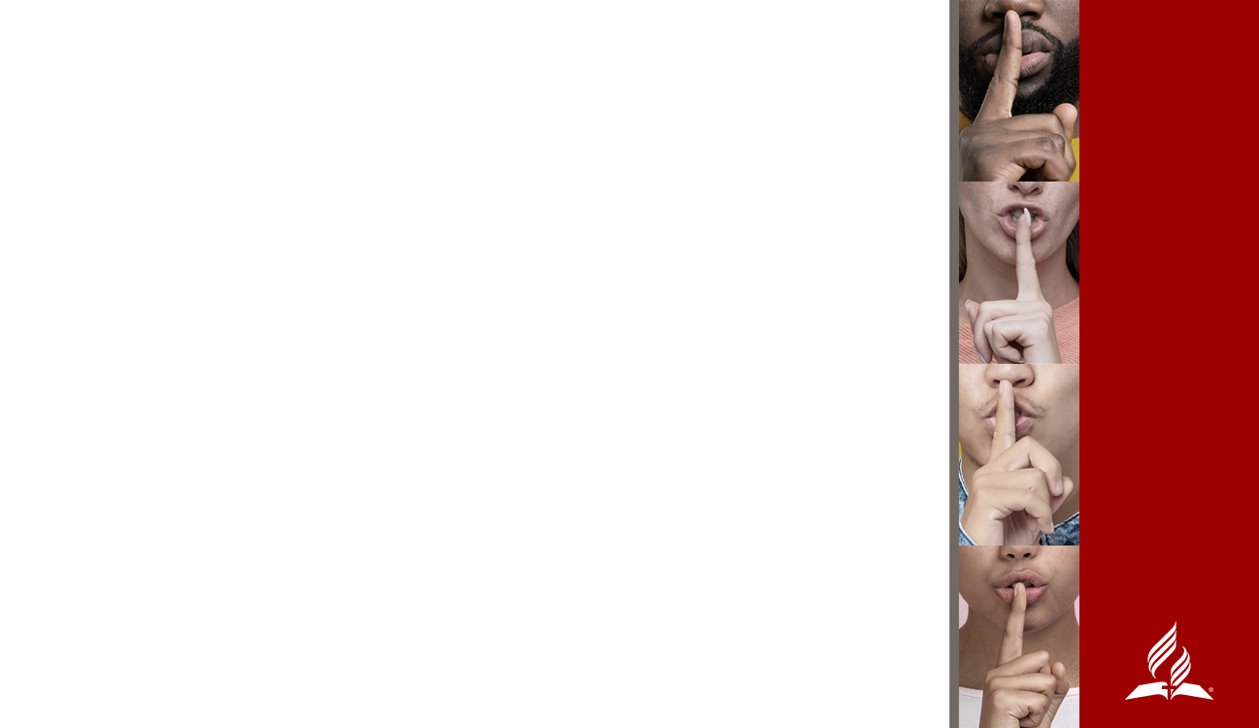
Ephesians. 4:1 and following, Paul wrote that believers are urged to “…live a life worthy of the calling you have received….Be completely humble and gentle; be patient…keep the unity of the Spirit through the bond of peace.”
Paul continues in v. 17-19, warning us of the futility of wrong thinking and action which leads to darkened understanding, separation from the life of God “because of the ignorance that is in them due to the hardening of their hearts.”
Verse 23 invites us to both a new attitude and a new self, “created to be like God in true righteousness and holiness.”
Notes:
Starting in Ephesians 4:1 and following, he wrote that believers are urged to “…live a life worthy of the calling you have received….Be completely humble and gentle; be patient…keep the unity of the Spirit through the bond of peace.” If we actually lived like that, no abuse would exist at any level! No one would be taking advantage of another because they have the power to do so.
Paul continues in 4:17-19 warning us of the futility of wrong thinking and action which leads to darkened understanding, separation from the life of God “because of the ignorance that is in them due to the hardening of their hearts.”
Do you see the contrast? Do you feel the gut-level impact of those contrasting states? One is worthy of the calling you have received, humble, gentle, patient, keeping the unity of the Spirit. The other is full of wrong thinking and action which leads to darkened understanding and ultimately separation from the life of God.
Verse 23 invites us to both a new attitude and a new self, “created to be like God in true righteousness and holiness.”
Here is the Master Artisan, using the sharp edges of truth to shape and change us from being either abusers or victims—or both—to a beautiful display of His presence.

Slide 12
In 4:26 he deals with the reality that we will at times be angry. Yes, we will be angry! Even Jesus got angry (Mark 3:5), but He was never abusive. Anger is just like the sharp instrument demonstrated at the beginning of this sermon.
Paul continues in Ephesians 5:1, we are to imitate God and “live a life of love.”
If we live lives focused on those compelling positive characteristics (accountability, mutuality, respect, and collaboration), we won’t be exasperating, provoking, or “hassling” each other—or even our own children (6:4). Our marital relationships will be built on equity, respect, and mutual submission to each other and especially to God.
Notes:
But Paul goes on. In 4:26 he deals with the reality that we will at times be angry. Yes, we will be angry! Even Jesus got angry (Mark 3:5), but He was never abusive. Anger is just like the sharp instrument demonstrated at the beginning of this sermon. Anger can be violently destructive, and abusive, or we can be so angry about something that is wrong that we are compelled to move to a positive solution; we are compelled to change the abusive injustice or behavior. Keep clearly in mind that anger is never to be an excuse for any kind of abuse. Never. Ever. “In your anger do not sin. Do not let the sun go down while you are still angry, and do not give the devil a foothold,” is how Paul puts boundaries on that very human emotion.
Rather, Paul continues in Ephesians 5:1, we are to imitate God and “live a life of love.” The original word Paul uses for imitate is mimetai, from which we get the word “mimic or imitate.” There is only one way we can do that: we must intently look at and to God; to concentrate on His characteristics, and then seek to incorporate those same characteristics into our daily living—to be like Him and to reflect His character to those around us. To do less, Paul says, is to give the devil not only a foothold, but the key to the front door.
We are to “…find out what pleases the Lord” (5:10), and to “be very careful…how we live—not as unwise, but as wise, making the most of every opportunity…” (5:15).
If we live lives focused by those compellingly positive characteristics (accountability, mutuality, respect, and collaboration), we will “submit to one another out of reverence for Christ” (5:21). Do you see the mutuality here? Then in all of our relationships—and Paul unfolds family relationships clearly in the rest of the chapter and book—we will reflect the accountability, mutuality, respect, and collaboration that represents our process of being shaped into artistic and beautiful imitators of God. This is the opposite of abuse of power!
If we live lives focused on those compellingly positive characteristics (accountability, mutuality, respect, and collaboration), we won’t be exasperating, provoking, or “hassling” each other—or even our own children (6:4). Our marital relationships will be built on equity, respect, and mutual submission to each other and especially to God.

Slide 13
A KNIFE—OR ANY SHARP INSTRUMENT—CAN BE USED TO HARM, TO CUT, TO WOUND, TO DEFACE, THAT SAME SHARP INSTRUMENT CAN CREATE SOMETHING BEAUTIFUL.
POWER IS JUST THE SAME. IT CAN BE USED TO HELP CREATE A BEAUTIFUL LIFE SHAPED BY THE HOLY SPIRIT FOR ETERNAL GLORY.
Notes:
CONCLUSION
[Note to presenter: If you can, have something that has been carved—perhaps a beautiful carving in wood or stone, or even clay. Bring it out and display it for everyone to see.]
Just as a woodcarver can use his sharp instrument to create a beautiful design carved out of wood, in the same way that tool can be used to cut, to wound, to deface.
Power is just the same. It can be abused to harm others. Misuse and abuse of power destroys opportunities for bringing others to Christ, because abusive power pushes the abuser away from the divine design. It also pushes the abused away from the divine design.
Or power can be used to help create a beautiful life shaped by the Holy Spirit for eternal glory.
With Holy Spirit power we become artisans and co-laborers with God to make this world a more beautiful place. He wants us to lead people toward a beautiful future: and ultimately to a powerful and beautiful forever.

Slide 14
“…live a life worthy of the calling you have received….Be completely humble and gentle; be patient…keep the unity of the Spirit through the bond of peace.”
Ephesians. 4:1
Notes:
“…Live a life worthy of the calling you have received….Be completely humble and gentle; be patient….keep the unity of the Spirit through the bond of peace” (Ephesians 4:1-3).
When our lives are lived in this way, with this positive use and appreciation of power, we fully demonstrate the character of God, and attract others to Him in true worship. This is evangelism at its best. Misuse and abuse of power destroys opportunities for bringing others to Christ, because abusive power pushes the abuser away from the divine design, it also pushes the abused away.
APPEAL
As you sit here today, is the Holy Spirit speaking to your heart and mind asking you to work with Him to reach hurting people with His love and character? Can you feel that tug on your heart? I believe that God calls all of us to reach other women in pain, lonely women, women who have a history of abuse and sadness, depressed women, women who have tried to hide themselves in the background or in the last pew of our church. Whoever it is that God is calling you to reach and minister to, remember she is waiting. She is waiting for you. Don’t let her wait too long. If you want to answer God today and say, “Yes, I will serve, I will minister with and in Your name and love,” please stand with me as I pray.
—All texts in the sermon are taken from the New International Version unless otherwise noted.

